Slide 1
Crawford Storm Roof Damage Detection

Slide 2


Crawford Claim Upload Screen – Screen Prototype
Welcome to ATLAS global platform for Claims Processing
Enter your name
Alex Hales
Your Contact Number
+61-123-456-7890
SCREEN 1
Your Address
No 11 Downing Street, London, United Kingdon
Upload photo of damages
Your Policy Number
PMT 12345678
Upload floor plan and damage details
Fonts and Color palettes shared by Phil would be used during prototype and screen build
Enter Loss Details
Storm Damage to Roof
Submit Loss Details

Slide 3
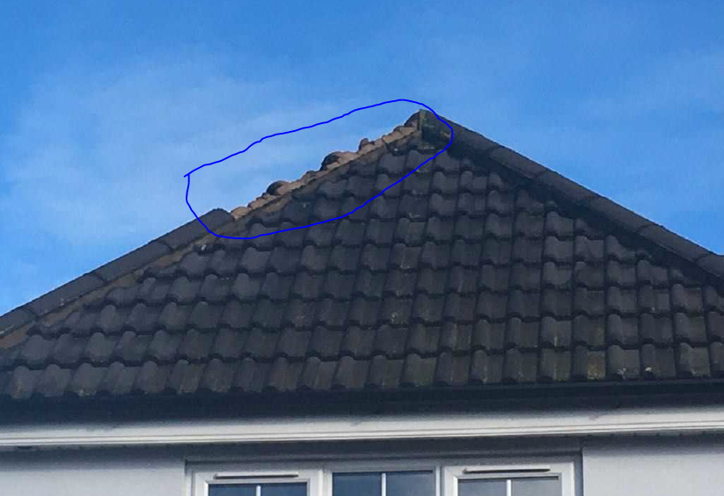
Crawford Claim Upload Screen – Screen Prototype(Contd)
Welcome to ATLAS global platform for Claims Processing
Please find below the details of your damage
SCREEN 2
Type of Damage
Roof Tile Damage
Type of Roof tile
Ridge tile
Fonts and Color palettes shared by Phil would be used during prototype and screen build
Damage estimates Schedule Total
£XXX.XX

Slide 4
Thank you

